Slide 1
U.S. Coast Guard Auxiliary Civil Rights Training
Notes:
Welcome to the US Coast Guard Auxiliary Civil Rights Training.
Independent Learner Instructions.
This document is derived from the mandatory training of the same name. It contains both images and narratives regarding the training topic and is provided in a “presenter notes” format.
As an independent learner you are expected to read all content contained in this document to include both the text within the images and the notes below the image (if any). Some images do not have notes or are self explanatory. As you work through this training material you should keep in mind that as an independent learner, you are responsible and accountable for learning and understanding the course content.
You should also understand its importance to our organization and the execution of our varied missions and be able to apply the knowledge gained through this independent training experience.

Slide 2
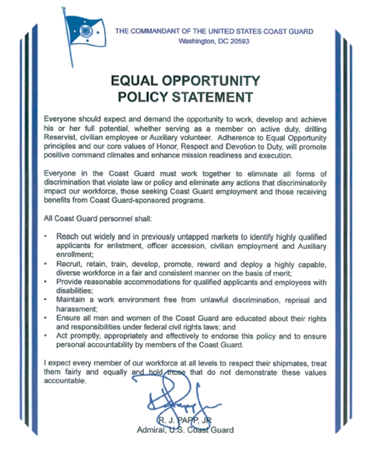
Notes:
The Commandant of the United States Coast Guard has created an equal opportunity policy statement. It should be read in its entirety, but note that there are two paragraphs that we have highlighted. First, “everyone should expect and demand the opportunity to work, develop and achieve his or her full potential whether serving as a member on active duty, drilling reserve, civilian employee, or auxiliary volunteer.” Second, “I expect every member of our workforce at all levels to respect their shipmates, treat them fairly and equally, and hold those that do not demonstrate these values accountable.”

Slide 3
Notes:
The Commandant of the United States Coast Guard also states in an anti-discrimination and anti-harassment policy statement that, “We will do this by creating climates and work environments that promote inclusion, equity, and respect.”
We will do this by creating command climates and work environments that promote inclusion, equity and respect. Every member of the workforce should be familiar with the coast guard equal opportunity and the "EEO" policies and should take proactive measures to prevent all forms of discrimination and harassment. We must eliminate conduct that unreasonably interferes with an individual's work performance or creates an intimidating, offensive, or hostile work environment on the basis of an individual's race, color, religion, sex, sexual orientation, national origin, age, disability, marital status, parental status, political affiliation, engagement in any protected EEO activity or any other basis protected by law.

Slide 4
Expectations
Understand the definition of civil rights
Understand language and imagery of civil rights
Importance of civil rights to the Auxiliary
Understand the many ways people are different
Leadership and membership responsibilities
Notes:
Civil rights are very important to the auxiliary. We understand the many ways people are different and how this affects our leadership and our membership and their responsibilities to one another.

Slide 5
What are civil rights?
All individuals have the same opportunities and rights conferred them by law and the Aux Manual
Constitutionally protected status such as race, color, religion, sex, age, national origin, or disability
Notes:
What are civil rights?
Civil rights are those rights that are conferred to people based on the laws and in the Auxiliary Manual. There are several constitutional laws that outline how people should be protected and this is the statutes of race, color, religion, sex, age, national origin and disability. There are also laws that protect additional statutes such as: sexual orientation, marital status, parental status, political affiliation, and genetic information.

Slide 6
Each person is representative of a mixture of “cultures and experiences”…
Each one can sow a “seed” of discrimination
SAMHSA, Office of Minority Health, and Health Resources and Administration, Quality Health Services for Hispanics: The Cultural Competency Component, 2001.
Notes:
From the office of Minority Health and Health Resources and Administration, there is a quote which states “Each person is representative of a mixture of cultures and experiences”…
This mixture of cultures and experiences is unique to everyone; therefore, each one of us is different from the other. It is in these differences that we find seeds of discrimination.

Slide 7
Definitions
Stereotype
Exaggerated belief, image or distorted truth about a person or group
Generalization with no individual differences
Prejudice
Opinion, prejudgment or attitude about a group or its individual members
Discrimination
Behavior that treats people unequally because of their group
Often begins with negative stereotypes and prejudices
Notes:
Let's explore some definitions related to civil rights.
There are several definitions that we need to understand in civil rights. A stereotype is when you see a group of people as different based upon some belief image or distorted truth. A stereotype could be that all blondes have diminished intelligence.
Prejudice is another word that comes into play in civil rights. A prejudice is when you have an attitude about a group or individual. This is similar to a stereotype but a prejudice is where you adjust your dealings with an individual or sometimes a group solely based upon an opinion or developed attitude.
Discrimination is the behavior that you display when you treat people unequally based upon the prejudice or stereotype that you hold.
The first is a stereotype. A stereotype is exaggerated belief image or distorted truth about a person or group of persons. It is a generalization with no individual differences.
A widely held but fixed and oversimplified image or idea of a particular type of person or thing
Stereotypes are qualities assigned to groups of people related to their race, nationality and sexual orientation, to name a few. Because they generalize groups of people in manners that lead to discrimination and ignore the diversity within groups, stereotypes should be avoided.
Some common stereotypes are: "the dumb blonde", the nerd (brilliant but antisocial with poor hygene and only drinks MT Dew), all redheads have fiery tempers, all tall young men must be basketball players, .... There are many other stereotypes and often people appear to fit the stereotype image, but that is the exception of the rule. I am sure we all know plenty of smart blondes and nerds with some good social skills that bathe regularly..,
Another important concept is Prejudice. Prejudice is a preconceived attitude or opinion or prejudgment about a group or its individual members either favorable or unfavorable..
Often the opinion or feeling is formed beforehand or without knowledge, thought, or reason.
These unreasonable feelings, opinions, or attitudes, are often of a hostile nature, regarding a racial, religious, or national group.
Prejudiced is based on stereotypes.
Some examples of prejudice statements: Never trust a (fill in the group name). old people are dangerous drivers, anybody with a southern accent is probably an uneducated hick,
Discrimination. This is defined as behavior that treats people unequally because of the group they belong to. it often begins with negative stereotypes and prejudices.
Some examples of discrimination: employer offering lower wages to a woman for the same job has a higher paid man. A woman is fired because she is pregnant. The bank refusing to loan money to a house buyer because the house he wants to buy is in a bad neighborhood.

Slide 8
Bias
Inclination or prejudice for or against one person or group in a way considered to be unfair
Perpetuated by conformity with in-group attitudes and socialization by culture at large to include mass media influences
Hidden bias: a bias of which you may be unaware….
Notes:
Bias is another element that influences discrimination.
The term biased is used to refer to the favoritism of one side or person over another. It is biased when you have to make a fair decision between the two
It is the inclination or prejudice against or for person or group in a way that is considered to be unfair.
Bias is when you have the inclination to use these stereotypes or prejudices in a way that would be unfair. For example, you date only blonds because you believe they are sexier, you hire only high school students who play in the band because everyone knows that they are the better students, or you ride your motorcycle with others who own Harleys because Harleys are the best. Culture tends to perpetuate bias. Advertisements tend to use sex to sell. The models are all young, attractive and dressed provocatively. Cologne ads have even gone so far as to depict that wearing specific cologne will guarantee you luck in your sex life. We watch enough of these ads and we began to get an idea of what a group of people are like or what a product should deliver. These act as hidden biases. A hidden bias occurs when you show a preference towards a group but are unaware of why you selected them. It is said that 70% of hidden biases are directed at African Americans, the elderly, the disabled and the overweight*. If you listen to several news reports nightly, it has been suggested that the overweight can’t help themselves, have no control, and are not smart enough to lose weight. Did you hear the hidden biases being perpetrated in those statements?
*Source: Babcock, Pamela. Detecting Hidden Bias. HR Magazine. Society for Human Resource Management, Feb. 2006. Web. 18 Jul. 2013. http://www.shrm.org/Publications/hrmagazine/EditorialContent/Pages/0206cover.aspx

Slide 9
Stereotypes
Prejudice
Bias
Discrimination
Violation of a person’s civil rights
Notes:
To sum up what we have just said, stereotypes, prejudice, and bias may lead into discrimination or harassment.
According to the Chapter 7.D.3.a, any Auxiliarist who believes they have been victims of, or subjected to, discrimination or discriminatory treatment within the Auxiliary because of recognized constitutionally protected status such as race, color, religion, sex, age, national origin, or disability have the right to file a complaint.

Slide 10
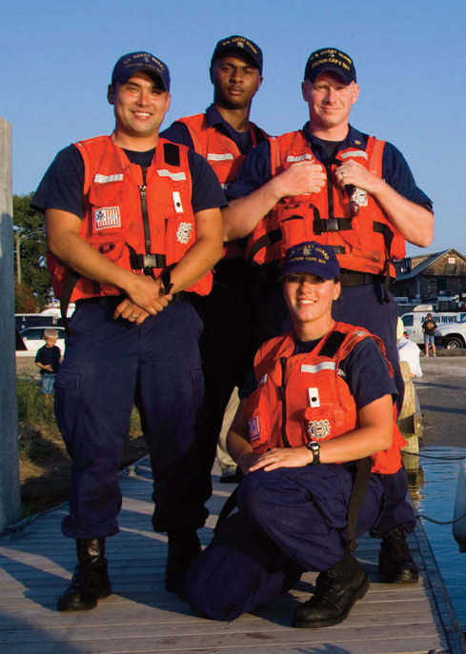
U.S. Coast Guard Auxiliary Diversity Mission
Build a positive work environment for all personnel …regardless of their similarities or differences
Create a climate of respect for people of all backgrounds
Spark innovation by incorporating new approaches and fresh perspectives to problem solving
Notes:
As we learned earlier, the coast guard and the coast guard auxiliary have a very distinct diversity mission. Driven from the top down, this mission encompasses the following key concepts:
The US Coast Guard’s Auxiliary diversity mission is to build a positive work environment for all personnel. There should be a climate of respect for people of all backgrounds. With multiple backgrounds people can bring new approaches and fresh perspectives to problem-solving. It is with fresh eyes or different approaches that innovation occurs.

Slide 11
Diversity Involves
Recognizing our unique differences
Recognizing how attitudes affect us all
Creating an environment where all can succeed
Developing a strong team environment of acceptance and trust
Acting to promote diversity
The Coast Guard considers diversity a matter of readiness.
Notes:
There is strength in our differences. All of us have unique differences and it is in self-examination that you determine how you approach this uniqueness. By self-examination you can find your hidden biases and correct those concepts leading to a strong team environment of acceptance and trust. You need to be a part of creating the environment where everyone can succeed and act to promote diversity within your group. When you work as a team your readiness for a mission is at its strongest.
Diversity for the coast guard and coast guard auxiliary involves
:
Recognizing our unique differences
Recognizing how attitudes affect us all
Creating an environment where all can succeed
Developing a strong team environment of acceptance and trust
Acting to promote diversity
Most importantly:
The Coast Guard considers diversity a matter of readiness.

Slide 12
USCG Core Values
Devotion to Duty
Respect
Honor
Notes:
Never forget the United States Coast Guard core values: honor, respect, and devotion to duty. These three work very close together meshing in the way that we would consider gears that mesh together. One fuels the other until when all three are working smoothly you have a very well-oiled Coast Guard team.

Slide 13
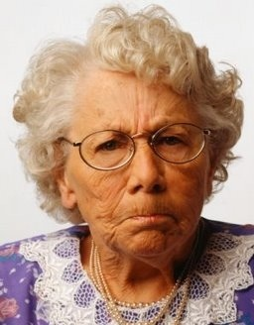
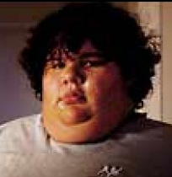
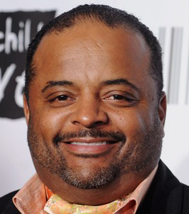
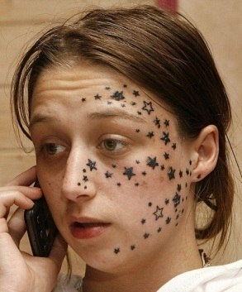
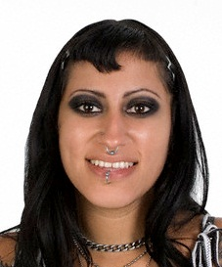
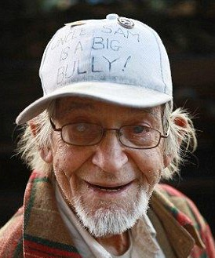
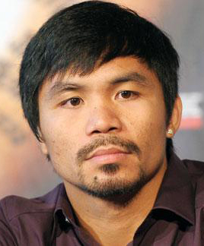
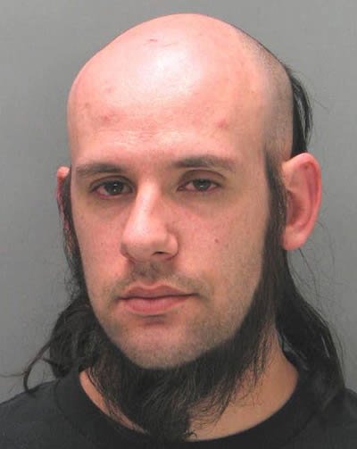
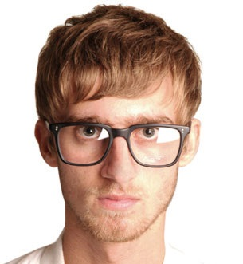
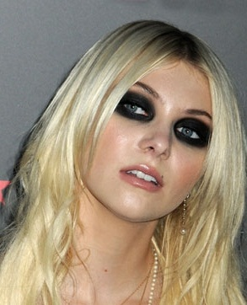
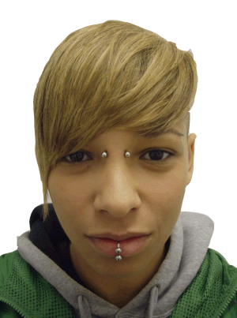
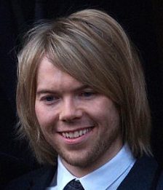
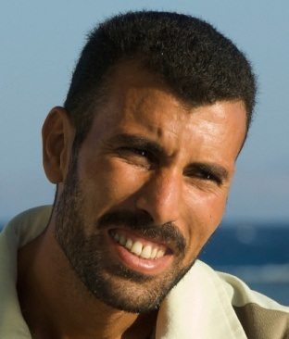
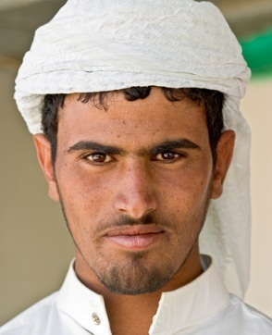
Who would you choose to join your flotilla?
Notes:
You are trying to increase the size of your flotilla and you hold a large activity to entice people to join your flotilla. Look at the faces that are appearing on this slide, and think about who you would choose out of this group of people to join your flotilla. As you look at the images, what points about the people are affecting how you view them as potential flotilla members?
Would the fact that several have piercings have a negative impact? Would there age (elderly or very young) or race cause you to mentally place them out of the running? How about their hair (too long, dyed, bald, curly, or gray) would that make you overlook them as a possible flotilla mate? What if they wore glasses would you silently think that they would not be able to see as well as someone else on the boat crew? Does the over use of makeup make the person undesirable to be part of your flotilla? Would you discount the two overweight individuals as being unfit? Personally you think tattooing is ugly, would you discount the young girl with stars on her face? What about religion? Would you let someone who looks like they have an attitude change your mind about letting them join? Would gender play a role in your acceptance? As you look through all these images, did you find yourself eliminating some people based upon a hidden bias?
Is there anyone in this group that according to the Coast Guard Auxiliary Manual that would be prohibited from joining your flotilla? The answer is yes. The young woman with the facial tattoos could not join. She would be excluded based upon the Auxiliary Manual Section 10.C.3.H. which states that visible tattoos on the head or neck are prohibited unless for legitimate medical purposes.
Others might have to make modifications based upon the Auxiliary Manual such as removing piercings, trimming their hair, removing excessive makeup, and modifying their religious clothing.
Additional Instructor Notes:
A good discussion can be had about our various differences without the "labels" being placed on each individual picture. For example; the “Race?” label is only used on certain individuals. All individuals belong to or self-identify with a particular race. The same applies to color, sex/gender, National origin, Religion (or lack of), etc.
Without the labels, individuals can still reflect upon any personal bias they may have with the limited information portrayed in the various pictures.
If a discussion points out the differences, it may be a good time to discuss commonalities, such as family concerns, stability, job security, etc., as well as the common goal of wanting to serve, wanting to be a member of the Coast Guard Auxiliary and wanting to promote its goals and missions.

Slide 14
Scenario 1
Julie Fisher
Active member of your flotilla
Boat crew member
Good worker, easy going
Last week you received this announcement in the mail
You are against same sex marriages
How do you react?
Notes:
Scenario 1
You and everyone in your flotilla have received a wedding announcement from Julie Fisher, a fellow flotilla member wedding. You notice upon reading the announcement that Julie married Lena Daniels and you are against same-sex marriages. How would you react?
This is clear cut. There can be no discrimination or harassment of members due to their sexual preference. Any such actions would be contrary to the Commandant’s Anti-Discrimination and Anti-Harassment Policy and may be a violation of law. You do not approve of her lifestyle, but while you work with her within the auxiliary your attitude should never be on display, nor interfere with your assignment or interaction with Julie.

Slide 15
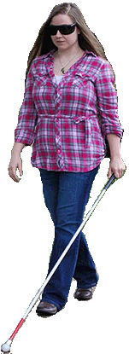
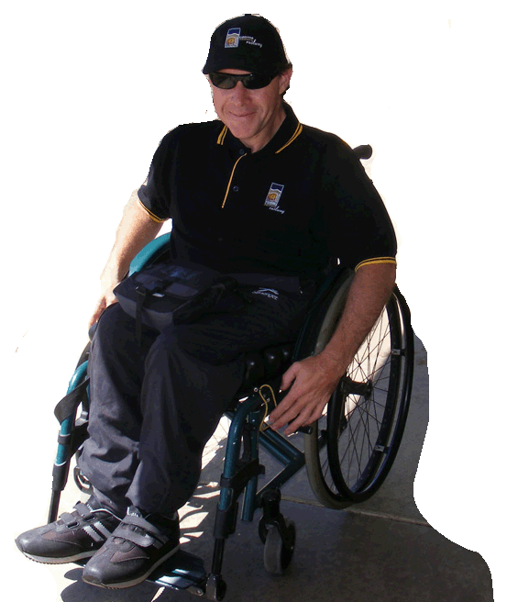
Scenario 2
You are at your flotilla meeting when the two new individuals (shown on the right) walk in the door and ask about joining
How are you going to respond?
Notes:
Scenario 2
At a flotilla meeting, two individuals walked-in and asked to join. Both are disabled, one is blind and one is wheelchair-bound. How you going to respond?
This is clear cut. All Auxiliarists are expected to eliminate conduct that unreasonably interferes with an individual’s work performance or creates an exclusive, intimidating, offensive, or hostile work environment based on discriminatory factors. Auxiliarists are expected to promote and exercise professionalism at all times. Concurrently, Auxiliary enrollees are expected to successfully meet all enrollment eligibility criteria and requirements through their own effort and achievement. Chapter 5 of the Auxiliary Manual states “The Auxiliary may take reasonable steps to accommodate individuals with physical or mental disabilities who desire to participate in Auxiliary events, programs, activities, and PE classes” (e.g., a blind person may have a New Member exam read to them by an Auxiliarist in order to answer the questions).

Slide 16
Scenario 3
You welcome both individuals into your flotilla.
How should your flotilla ensure that they are properly included as members of the Coast Guard Auxiliary?
Notes:
Scenario 3
After welcoming both individuals into your flotilla, how could you ensure that they are properly included as members of your flotilla?
The flotilla should talk to them about their expectations, limitations, and desires. Then discuss the areas of participation that your flotilla is involved in and find one that they can excel in and benefit your flotilla. There will be jobs that, because of their disability, limit their participation, but there are other jobs where they can excel and fulfill all requirements.

Slide 17
Scenario 4
Arthur joined your flotilla and wants to qualify for boat crew. You decide that the only time you will patrol is on Saturdays. Arthur comes to you and tells you he is a Seventh Day Adventist and cannot go out on Saturday. What should you do?
Notes:
Scenario 4
Arthur, a new flotilla member, wants to work at qualifying for boat crew. Your flotilla has set up the operational patrols on Saturdays. Saturday was picked because the facility was available on the weekends and those who were boat crew qualified wanted Saturday so it did not interfere with Sunday activities. Arthur’s joining came after the schedule was set. Arthur informs you that he is seventh day Adventist and cannot go out on a Saturday. What should you do? Try to make a reasonable effort to accommodate the member’s request.
If you do not address the issue, the member could file a civil rights complaint. The obvious solution is to make a few patrols on other days, but if it is not possible due to the both the facility availability and crew availability then other flotillas could be approached to arrange a patrol that Arthur could work on. Arthur would still participate and train in his own flotilla.

Slide 18
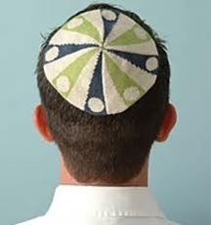
Scenario 5
Jacob has joined your flotilla. He shows up for boat crew duty and when he exits his car you notice that he is in uniform and wearing a highly decorated yarmulke. You approach the car to talk to him – what do you say?
Notes:
Scenario 5
Jacob has joined your flotilla and has become boat crew qualified. For one of your patrols, he shows up for duty and when he exits his car you notice that he is in uniform and wearing a highly decorated yarmulke.
You welcome him and then ask him if he has brought a yarmulke with him that will meet the axillary manual rules. If he was not aware of the rules, you must explain them. You should ask if he has a plain yarmulke with him. You should check to see if it fits beneath his uniform head gear.
Auxiliary manual 10.C.3.R states that religious head gear:
Must be black or match the hair color
Cannot bear any writing, symbols, or pictures
Must be a style that can be completely covered by, and not interfere with, the wearing or appearance of any uniform head gear
Cannot cover any portion of face or auxiliary head gear

Slide 19
Scenario 6
Wayne, one of your best coxswains, always goes out with a crew of men. When a qualified woman requests to join the crew, he always finds a way to refuse. What should you do?
Notes:
Scenario 6
Wayne seems to be refusing to allow woman to join his boat crew. What should you do? This could escalate to a complaint being filed, and it requires proper investigation and validation of the concern prior to communicating it to Wayne.
You should explain to him what his behavior is communicating to others. If there is a misunderstanding, then clarification should be straightforward. If actions are intentionally discriminatory, then he should be advised of such and that notification will be made up the chain of leadership.

Slide 20
Scenario 7
You are performing a Qualification Exam for an elderly (80 yrs) coxswain and realize that his/her skills have noticeably diminished. Upon notifying him/her that he/she failed the exam, he/she complains that you are discriminating due to age. How do you handle this?
Notes:
Scenario 7
Truthfully examine your attitude to see if there was hidden bias. You should be always very meticulous when writing down the results and findings. With good notes you can verify that it was the results you were judging. An unqualified crew member could possibly create a situation where instead of saving the victim, you have now another victim to worry about. Instead of adding to the solution, they would add to the problem. There are several relevant and applicable references to help guide and support such an assessment (Auxiliary Manual sections 5.P.2. And 8.A.3., and Auxiliary Operations Policy Manual section 1.L.)
You could schedule training with another flotilla member and then reschedule another qualification exam with another examiner that does not know the results and get a second opinion.

Slide 21
Managing Auxiliary Civil Rights Complaints
How is a complaint filed?
How long does a person have to file a complaint?
To whom is the complaint submitted?
How long is the time frame for resolution?
What happens if it cannot be resolved at the lowest level?
What next?
Best reference: CG Auxiliary Manual, Chapter 7
Notes:
There will be conflicts. The Coast Guard Auxiliary has outlined how civil right complaints must be handled. This is outlined in Chapter 7 of the Coast Guard auxiliary manual. Read this chapter to learn more.

Slide 22
Filing an Auxiliary Civil Rights Complaint
Filed informally in writing
Given to Auxiliarist’s FC
Other higher Auxiliary elected leader, if appropriate
Within 45 days of alleged incident
Electronic mail submission satisfies requirement
Notes:
When filing an auxiliary civil rights complaint, it must be filed informally in writing. There is no official form to fill out. The written complaint is given to the auxiliary’s FC or to another higher auxiliary elected leader when appropriate. The complaint must be filed within 45 days of the alleged incident. The Coast Guard Auxiliary recognizes electronic mail submission as satisfying the requirement of a written complaint.

Slide 23
Auxiliary Civil Rights Complaint Requirements
Complainant’s full name
Complainant's Auxiliary member ID number
Date of incident
Statement indicating complainant’s wish to file informal complaint of discrimination
Brief summary of nature of complaint
Notes:
The requirements of an Auxiliary civil rights complaint includes:
The complainant’s full name, the complainant’s auxiliary member ID number, the date of the incident, a statement indicating the complainants wish to file the informal complaint of discrimination, and a brief summary of the nature of the complaint.

Slide 24
Auxiliary Civil Rights Complaint Resolution
Should be resolved at lowest organization level
FC or other officer has 15 days to resolve complaint
Make separate contact with both the complainant and alleged offender
Facilitate communication between complainant and alleged offender for resolution
If resolved, FC keeps written complaint and record of agreed resolution at flotilla for one year
Notes:
All auxiliary civil rights complaints should be resolved at the lowest organizational level.
Once filed the FC has 15 days to resolve the complaint. During these 15 days the FC or other officer will make separate contact with both the complainant and the alleged offender. The FC will facilitate communication between the complaint and the alleged offender for resolution of the complaint. If the complaint is resolved, the FC will keep the written complaint and the agreed resolution on file at the flotilla for one year.

Slide 25
Unresolved Auxiliary Civil Rights Complaint
Inquiry shall be conducted by appropriate CGAUX-CRC
Forward all material
Arrange for meeting of complainant and CGAUX-CRC
Has 30 days to investigate and determine if complaint can be resolved
Notes:
If the Auxiliarist's civil rights complaint is unresolved, the inquiry shall be conducted by the appropriate Coast Guard Auxiliary Civil Rights Coordinator. All the material should be forwarded to the Civil Rights Coordinator and a meeting arranged between the complainant and the Civil Rights Coordinator. The Coast Guard Auxiliary Civil Rights Coordinator has 30 days to investigate and determine if the complaint can be resolved.

Slide 26
Auxiliary Civil Rights Complaint -Alternate Approach
Anyone can file complaint directly to CGAUX-CRC
Same time frame – 45 days to file
CGAUX-CRC has 30 days to investigate and respond
Different procedure is followed
See Auxiliary Manual, Section 7.D.4.C
Notes:
There is an alternative approach to filing the complaint. Anyone can file their complaint directly to the Coast Guard Auxiliary Civil Rights Coordinator. All the time frames remain the same; 45 days to file from the date of the incident and the civil rights coordinator has 30 days to investigate and respond. For the appropriate procedure for an alternate approach see the Auxiliary Manual, Section 7.D.4.C.

Slide 27
Auxiliarist’s Role in Civil Rights
Be aware of your organization’s diversity
Be aware of conflicts or potential conflicts
Embrace the provisions of the Coast Guard’s Diversity, Anti-Discrimination/Anti-Harassment, and Equal Opportunity Policy Statements
Exemplify the Coast Guard’s Core Values
Whatever role you play in the Auxiliary,
LEAD BY EXAMPLE!
Notes:
So what is the Auxiliarist's role in civil rights? The Auxiliarist should always be aware of the organization’s diversity and be aware of any conflicts or potential conflicts that could exist within your group. You should embrace the provisions of the Coast Guard’s diversity antidiscrimination anti-harassment and equal opportunity policy statements. By accepting the policy statements and exemplifying the Coast Guard’s core values, you will be an Auxiliarist that the U.S. Coast Guard will be proud to embrace.
Whether you play a leadership role or are part of the general membership, your example should lead others in accepting diversity and maintaining individual civil rights.

Slide 28
Cultural ALLIES Promote Inclusion
Always checking assumptions made about others
Listening with openness to understand
Leading by example – being consistent, timely, fair, and flexible
Inviting honest feedback and open dialogue
Engaging in continuous diversity learning
Standing up for differences by addressing injustice, inequity, disrespect, and exclusion
Notes:
In conclusion, by accepting individuals’ diversity and honoring their opinions we become better allies. By definition, being allies mean working together to accomplish great things. By creating an acronym of the word allies, we can state methods that will lead to us becoming better Auxiliarist.

Slide 29
Completed Training Attestation
Coast Guard Core Values
Honor
Integrity is our standard. We demonstrate uncompromising ethical conduct and moral behavior in all of our actions. We are loyal and accountable to the public trust.”
Respect
We value our diverse workforce. We treat each other with fairness, dignity, and compassion. We encourage creativity through empowerment. We work as a team
Devotion to Duty
We are professionals, military and civilian, who seek responsibility, accept accountability, and are committed to the successful achievement or our organizational goals. We exist to serve. We serve with pride.
Notes:
The mandatory training that you have just completed is reflective of the Core Values of the U.S. Coast Guard and Coast Guard Auxiliary. As a member of this organization, you have taken an oath to uphold those Core Values. In order to receive completion credit for this training, please read, understand, & sign this document. Once completed, keep a copy for your records and provide a copy to the appropriate member of your flotilla leadership.
In regards to this training module: Civil Rights Awareness, with code: CRA,
I,________________________________, as member of District_____ Division____ Flotilla______ agree that I have read and understand the contents of this training course as indicated by my checking the box below.
I have thoroughly read and understand the contents of this training course (place check mark in box)
Signature:__________________________________ Member ID:_______________________
Date:_____________

