Slide 1
U.S. Coast Guard Auxiliary Influenza Training
Notes:
Welcome to the US Coast Guard Auxiliary Influenza Training.
Independent Learner Instructions.
This document is derived from the mandatory training of the same name. It contains both images and narratives regarding the training topic and is provided in a “presenter notes” format.
As an independent learner you are expected to read all content contained in this document to include both the text within the images and the notes below the image (if any). Some images do not have notes or are self-explanatory.
As you work through this training material you should keep in mind that as an independent learner, you are responsible and accountable for learning and understanding the course content.
You should also understand its importance to our organization and the execution of our varied missions and be able to apply the knowledge gained through this independent training experience.

Slide 2
Lesson 1: Influenza Types and Symptoms

Slide 31
Lesson 2: Influenza Prevention

Slide 44
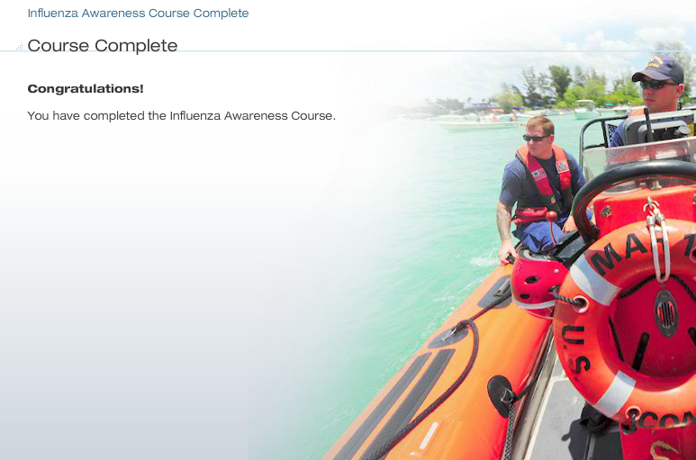

Slide 45
Influenza Knowledge Check
Instructions: Please complete the quiz by writing down on an answer sheet ( if provided) the best answer for each of the following 10 questions regarding what you learned about influenza. You must score 80% or better to pass.
Humans typically have little or no immunity to which type of influenza?
A. Seasonal influenza
B. Pandemic influenza
C. None of the above
Pandemic influenza causes local outbreak of mild illness.
A. True
B. False
Notes:
Answers:
B. Pandemic influenza
B. False

Slide 46
Influenza Knowledge Check
What is a sign that you might be ill with the influenza virus?
A. Chills accompanied by sweating
B. Numbness in your fingers
C. Bloody nose
D. Itchy scalp
There has not been an influenza pandemic since 1918.
A. True
B. False
Notes:
Answers:
A. Chills accompanied by sweating
B. False

Slide 47
Influenza Knowledge Check
Social distancing involves maintaining a minimum distance of____feet from infected individuals.
A. 0 feet
B. 1 foot
C. 2 feet
D. 3 feet
If you are ill, you should just stay on your side of the shared cubicle until it is time to call home.
A. True
B. False
Notes:
Answers:
D. 3 Feet
B. False

Slide 48
Influenza Knowledge Check
A coworker is coughing and sneezing frequently and complaining of fevers and chills. What do you do?
A. Go over to the coworker and pat him on the back asking if he is OK.
B. Go over to the coworker and offer him a sip of your water.
C. Shrug and do nothing-he will stop coughing and feel better later.
D. Maintain social distancing and asked his supervisor to advise him to go home.
Who should get the seasonal influenza vaccine?
A. Everyone 6 months and older (if there is no medical contradiction)
B. Only pregnant women
C. Only healthcare worker
D. Only people with chronic medical conditions
Notes:
Answers:
D. Maintain social distancing and asked his supervisor to advise him to go home.
A. Everyone 6 months and older (if there is no medical contradiction)

Slide 49
Influenza Knowledge Check
What is the proper way to cough and sneeze without spreading contaminated droplets?
A. Use a tissue and keep it in your pocket for next time.
B. Use the palm of your hand and wipe it on your pant leg.
C. Use the crux of your elbow.
D. Use cloth handkerchief and keep it folded in your desk drawer.
Which of the following populations are most at risk of suffering serious health complications as a result of seasonal influenza?
A. Older people
B. Very young children
C. People with existing health conditions
D. All of the above
Notes:
Answers:
C. Use the crux of your elbow
D. All of the above

