Slide 1
Sexual Assault Prevention and Response
Mandated Training Series
Notes:
Welcome to the US Coast Guard Auxiliary SAPR Training.
Independent Learner Instructions.
This document is derived from the mandatory training of the same name. It contains both images and narratives regarding the training topic and is provided in a “presenter notes” format.
As an independent learner you are expected to read all content contained in this document to include both the text within the images and the notes below the image (if any). Some images do not have notes or are self explanatory. As you work through this training material you should keep in mind that as an independent learner, you are responsible and accountable for learning and understanding the course content.
You should also understand its importance to our organization and the execution of our varied missions and be able to apply the knowledge gained through this independent training experience.

Slide 2
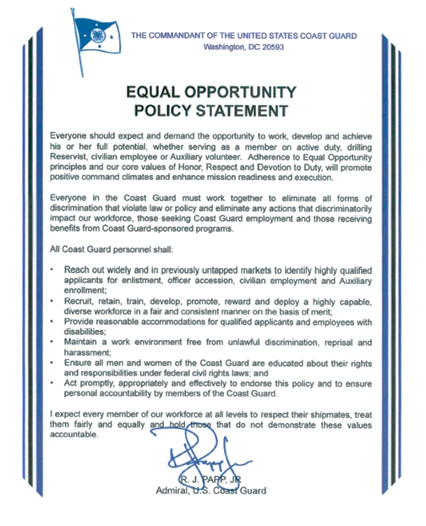
Notes:
The Commandant of the United States Coast Guard has created an equal opportunity policy statement. It should be read in its entirety, but note that there are two paragraphs that we have highlighted. First, “everyone should expect and demand the opportunity to work, develop and achieve his or her full potential whether serving as a member on active duty, drilling reserve, civilian employee, or auxiliary volunteer.” Second, “I expect every member of our workforce at all levels to respect their shipmates, treat them fairly and equally, and hold those that do not demonstrate these values accountable.”

Slide 3
Everyone should expect and demand the opportunity to work, develop and achieve his or her full potential, whether serving as a member on active duty, drilling Reservist, civilian employee or Auxiliary volunteer. Adherence to Equal Opportunity principles and our core values of Honor, Respect and Devotion to Duty, will promote positive command climates and enhance mission readiness and execution.
Notes:
The Commandant of the United States Coast Guard has created an equal opportunity policy statement. It should be read in its entirety, but note that there are two paragraphs that we have highlighted. First, “everyone should expect and demand the opportunity to work, develop and achieve his or her full potential whether serving as a member on active duty, drilling reserve, civilian employee, or auxiliary volunteer.” Second, “I expect every member of our workforce at all levels to respect their shipmates, treat them fairly and equally, and hold those that do not demonstrate these values accountable.”

Slide 4
I expect every member of our workforce at all levels to respect their shipmates, treat them fairly and equally and hold those that do not demonstrate these values accountable.
Notes:
The Commandant of the United States Coast Guard has created an equal opportunity policy statement. It should be read in its entirety, but note that there are two paragraphs that we have highlighted. First, “everyone should expect and demand the opportunity to work, develop and achieve his or her full potential whether serving as a member on active duty, drilling reserve, civilian employee, or auxiliary volunteer.” Second, “I expect every member of our workforce at all levels to respect their shipmates, treat them fairly and equally, and hold those that do not demonstrate these values accountable.”

Slide 5
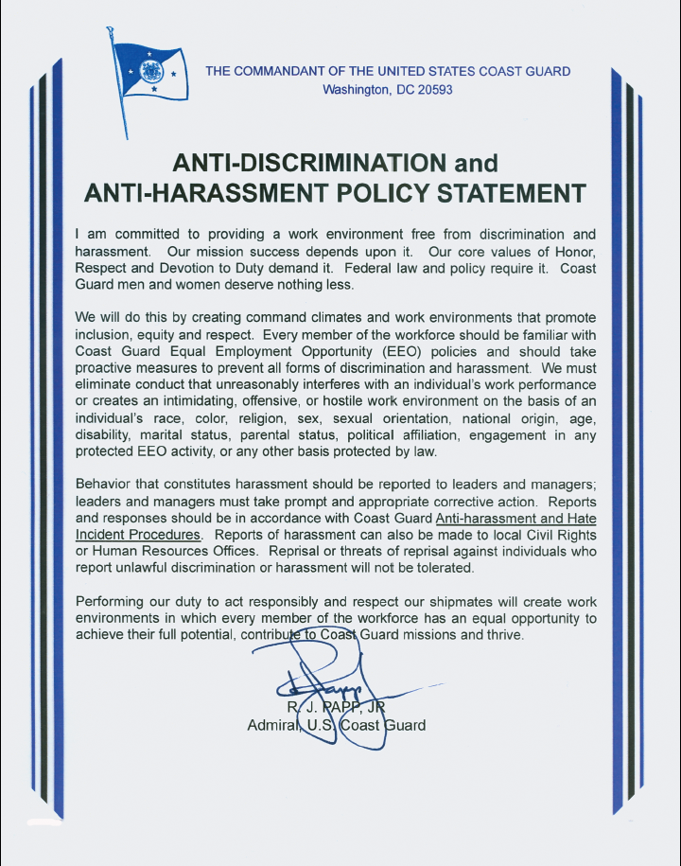
Notes:
The Commandant of the United States Coast Guard also states in an anti-discrimination and anti-harassment policy statement that, “We will do this by creating climates and work environments that promote inclusion, equity, and respect.”

Slide 6
We will do this by creating command climates and work environments that promote inclusion, equity and respect. Every member of the workforce should be familiar with the coast guard equal opportunity and the "EEO" policies and should take proactive measures to prevent all forms of discrimination and harassment. We must eliminate conduct that unreasonably interferes with an individual's work performance or creates an intimidating, offensive, or hostile work environment on the basis of an individual's race, color, religion, sex, sexual orientation, national origin, age, disability, marital status, parental status, political affiliation, engagement in any protected EEO activity or any other basis protected by law.

Slide 7
Expectations
Recognize: There is a difference between unacceptable and acceptable conduct
Prevent: Sexual assault can often be prevented
Respond: Sexual assault needs to be responded to appropriately

Slide 8
Expectations
In order to prevent and respond to sexual assault, you will need to recognize the difference between appropriate and inappropriate sexual conduct
Knowing what actions you and others can take to prevent becoming a sexual assault offender or victim can help keep you out of trouble. Furthermore, there are actions you can take to help others avoid potentially dangerous situations
When sexual assault does occur, appropriate response can do much to protect and help to heal victims and bring offenders to justice

Slide 9
This learning opportunity will help you to recognize, prevent, and respond to sexual assault appropriately. As a member of the Coast Guard workforce, you must be able to answer these questions:
How do I recognize incidents of sexual assault?
How can I prevent myself and others from being involved?
How do I respond as either a victim or someone in a position to help a victim?
Knowing the answers to these questions and acting on this knowledge can help you make a significant difference in your life and the lives of others.

Slide 10
Course sections
Introduction
Recognize: Where is the Line?
Prevent: How Do I Protect Myself?
Respond: What Do I Do Now?
Prevent & Respond: How Do I Help Others?

Slide 11
Introduction to
Sexual Assault Prevention and Response
Not all those you can save are at sea. Your fellow Coast Guard members and the civilians in your community may need your help.
Sexual assault has a negative effect on our society, but in this course, you will learn about your roles and responsibilities in Recognizing, Preventing, and Responding to sexual assault so that you can be a Guardian.
Recognize sexual assault
Prevent sexual assault by minimizing risk to you and others
Respond to sexual assault whether you or others are the victim
This section presents a scenario in two parts that explains the effects of sexual assault. It also includes a chart showing the possible consequences of sexual assault on victims, secondary victims, and offenders.

Slide 12
Scenario 1
Return to Course Sections

Slide 13
Scenario 1
At a morale party, Nate managed to convince fellow coastguardsman Silvia to have a few drinks. At first, she resisted but eventually, she started drinking heavily.
Not thinking straight, Silvia let Nate take her back to her place where they made out. She passed out and later, woke up to find Nate having sex with her. She was too frightened and shocked to resist or tell him to stop.
Trying to go about her daily routine over the next several weeks, Silvia felt guilty that she had let herself get into that situation and surprised that Nate took advantage of her like that.
Her inability to stop Nate had made her feel weak and helpless. She struggled to concentrate at work and elsewhere and crying fits became a regular occurrence.
She had little appetite and rarely enjoyed even her favorite activities. Her insomnia worsened when she started having vivid nightmares where she relived that night.

Slide 14
What do you think of Silvia’s reaction to the incident?
She needs to just get over it—what she’s going through is all in her head
It’s a natural reaction but she’ll be alright soon
She needs to find help—this could continue to severely impact her life

Slide 15
What do you think of Silvia’s reaction to the incident?
This is sexual assault, which is often a major traumatic event in a victim’s life. Victims may experience similar symptoms to Silvia’s with devastating impacts to their personal and professional lives. Some symptoms are physical (e.g. injuries, potential pregnancy, or sexually transmitted diseases). Psychological impacts are not always visible but just as serious and real, such as Rape Trauma Syndrome, a form of Post-traumatic Stress Disorder.

Slide 16
Could Nate be punished for what happened?
Yes, under the UCMJ
Yes, under civil law
No, because Silvia consented
No, because he did not use force

Slide 17
Could Nate be punished for what happened?
This is sexual assault, which is often a major traumatic event in a victim’s life. Victims may experience similar symptoms to Silvia’s with devastating impacts to their personal and professional lives. Some symptoms are physical (e.g. injuries, potential pregnancy, or sexually transmitted diseases). Psychological impacts are not always visible but just as serious and real, such as Rape Trauma Syndrome, a form of Post-traumatic Stress Disorder.

Slide 18
Could fellow coastguardsmen be negatively affected by what happened?
Yes, it could have a profound effect on them
Maybe, they may talk about it for a day or two and then move on
No, it will not have any effect on them

Slide 19
Could fellow coastguardsmen be negatively affected by what happened?
Commandant Instruction 1754.10 (series) states that “ultimately [sexual assault] destroys unit cohesion and the trust that is essential for mission success.” The reputation of the Coast Guard, as a humanitarian organization, is tarnished when cases like this arise. Nate’s mentors and subordinates may be shocked, disappointed, and saddened by his decisions; morale, and ultimately job performance, will be negatively impacted.

Slide 20
The possible consequences of sexual assault
The victim:
Loss of a sense of security and safety
High levels of caution about forming new relationships
Difficulty with sexual relations (some shying away from it; others using hyper-sexuality as an attempt to show power and control)
Increased risk of dependency on alcohol, tobacco, or drugs
Increased risk of eating disorders
Development of phobias (such as fear of crowds, being alone, or going out).
Development of Rape Trauma Syndrome (a form of Post-traumatic Stress Disorder)

Slide 21
The possible consequences of sexual assault
The offender:
Under the Uniform Code of Military Justice (UCMJ): death, confinement, or other such penalty as directed by a court martial, imprisonment up to life (in cases of forcible sodomy), non-judicial punishment, including a reduction in grade and forfeiture of pay
Under civil laws: incarceration (with a certain number of years per each count), registration as sex offender (possibly for life), restitution to the victim, a felony record, negative media publicity, psychiatric treatment, significant fines

Slide 22
The possible consequences of sexual assault
Secondary victims:
Family, friends, coworkers, and acquaintances of victims are known as secondary victims and may also experience fear, anger, grief, denial, an urge to overprotect or retaliate, a loss of intimacy or trust, and/or victim blaming (which re-victimizes the victim)
Secondary victims often need some assistance in understanding their feelings and how to best help their loved one who is the primary victim. Employment Assistance Program Coordinators (EAPCs)/Sexual Assault Response Coordinators (SARCs), licensed counselors, rape crisis centers, or even simply informational pamphlets may be of help.

Slide 23
The possible consequences of sexual assault
Secondary victims:
This concludes the Introduction. As you can see, sexual assault may have many devastating and long-lasting effects on victims, offenders, and entire units and communities. In the next section, you will learn how to recognize sexual assault by learning the difference between acceptable and unacceptable behavior.
Return to Course Sections

Slide 24
Section A: Recognize: Where is the Line?
Before you can PREVENT and RESPOND to sexual assault, you must be able to RECOGNIZE the difference between acceptable and unacceptable sexual behavior.
While some situations are easy to identify as sexual assault, other situations may leave you confused as to what, if any, offense was committed. This section will help you answer the question, “Where is the line?”
Section Objective:
Define sexual assault, differentiating between inappropriate and appropriate conduct.
This section presents a sexual assault scenario, as well an article that defines sexual assault. It then presents several shorter scenarios which ask you to identify whether they are considered sexual assault or acceptable behavior. At the end of this section are several scenarios that will help you learn the difference between sexual assault and sexual harassment. Use the article to answer the scenario questions.

Slide 25
Section A: Recognize: Where is the Line?
Return to Course Sections

Slide 26
Section A: Recognize: Where is the Line?
Nate and Silvia were both at a morale party. Trying to get Silvia to “loosen up and enjoy herself,” Nate encouraged her to drink. She initially refused since she had had a couple drinks already, but he was persistent.
Finally, she decided that it was easier just to take the drink and hope he leaves her alone afterward. Over the course of the party, she forgot her goals to only drink a little and eventually, she ended up very drunk.
She and Nate flirted and Silvia even made some very suggestive comments. He asked her to leave with him. Silvia, now so drunk she was having trouble walking straight, agreed.
Back at her place, they made out. Silvia suddenly felt extremely dizzy and said she needed to lie down, then lost consciousness. When she came to, Nate was having sex with her

Slide 27
Section A: Recognize: Where is the Line?
Is this sexual assault?
  No, this cannot be considered sexual assault.
  Yes, Silvia was incapable of consenting.
  Yes, but only because she passed out.
Consent is words or overt acts by a competent person indicating that they agree to a sexual act. Silvia could not provide this consent because she was heavily intoxicated. Even if Silvia had said she wanted to have sex, it was Nate’s responsibility to realize that she was too drunk to make that decision and not have sex with her.
Read Article: Recognizing Sexual Assault

Slide 28
Section A: Recognize: Where is the Line?
But if she didn’t say “no,” why might it be considered sexual assault?
  Because she perceives herself as a victim and was incapable of giving consent while under the influence of alcohol
  Because legally only women can be assault victims when alcohol is involved
  Because they work together and Nate should have known that shipmates should never have sex with each other
An intoxicated person is unable to provide consent using overt acts. Even if both Silvia and Nate had been completely sober, in this situation, Silvia did not actually provide consent through words or overt acts. Nate cannot assume consent for a sexual act, even if Silvia consented to making out.
Read Article: Recognizing Sexual Assault

Slide 29
Section A: Recognize: Where is the Line?
Try to decide whether the following are examples of sexual assault or acceptable behavior. Each of the scenarios is followed by the answer and an explanation.
  Tracey and Scott drink heavily before he took her back to his place. They start fooling around. Scott tells Tracey that he feels like he is going to pass out. Tracey says, “Don’t worry” and they have sex.
Assault. Just because Scott didn’t distinctly say “no” doesn’t mean he consented. Someone who is intoxicated as a result of drug or alcohol use is never in a position to consent to sex.

Slide 30
Section A: Recognize: Where is the Line?
Try to decide whether the following are examples of sexual assault or acceptable behavior. Each of the scenarios is followed by the answer and an explanation.
  Sandra sends John text messages, including explicit pictures of herself, saying that she wants to have sex with him. Later, John initiates sex and Sandra says, "Not now." John ignores her because he thinks she’s playing "hard to get" and has sex with her.
Assault. Sandra has the right to change her mind at any time. Consent is not assumed just because Sandra had indicated previously that she wanted to have sex.

Slide 31
Section A: Recognize: Where is the Line?
Try to decide whether the following are examples of sexual assault or acceptable behavior. Each of the scenarios is followed by the answer and an explanation.
  LTJG Jones meets Maria at a bar where they dance and have drinks. Later that evening, Maria and LTJG Jones both verbally agree to, and have, sex. LTJG Jones later finds out that Maria is sixteen.
Assault. A minor is legally unable to consent. LTJG Jones was responsible for making sure that his partner was of age. His ignorance of her age cannot be considered a valid excuse.

Slide 32
Section A: Recognize: Where is the Line?
Try to decide whether the following are examples of sexual assault or acceptable behavior. Each of the scenarios is followed by the answer and an explanation.
  Your partner suggests that you have sex with him or her. The two of you already have an intimate relationship, but are not in agreement this night. Your partner physically forces to have sex with him or her.
Assault. It doesn’t matter if you and your partner had or even currently have an intimate relationship; consent must be gained. Forced sex with an intimate partner can be as traumatic as being raped by a stranger. A relationship or marriage is meant to be a mutual partnership; one partner does not become the property of the other.

Slide 33
Section A: Recognize: Where is the Line?
Try to decide whether the following are examples of sexual assault or acceptable behavior. Each of the scenarios is followed by the answer and an explanation.
  Mr. Smith (a supervisor) calls Carrie (his subordinate) into his office for a performance review and counseling session. Mr. Smith backs Carrie into a corner of his office and without either of them saying a word, they have sex.
What Mr. Smith did was an abuse of authority. It left Carrie feeling like she must submit to his demands or sacrifice her career. Using authority to gain sexual favors is a way of gaining power and control over an unwilling person and is considered sexual assault.

Slide 34
Section A: Recognize: Where is the Line?
Try to decide whether the following are examples of sexual assault or acceptable behavior. Each of the scenarios is followed by the answer and an explanation.
  Brad is waiting outside of a bar for a cab when he sees Susan who appears to be very drunk. He is very attracted to her, so he asks her for her phone number. Brad gives Susan his cab and gives her a call the following afternoon.
Acceptable behavior. Brad acted responsibly by asking Susan for her phone number, instead of taking advantage of her when she was drunk. He can ask her later when she’s sober, thus respecting her right to choose and allowing him to protect himself from the penalties of sexual assault.

Slide 35
Section A: Recognize: Where is the Line?
Try to decide whether the following are examples of sexual assault or acceptable behavior. Each of the scenarios is followed by the answer and an explanation.
  Jennifer had been drinking at the bar all evening. She sees Ryan, who in her opinion is a cute guy, also hanging out at the bar. Jennifer runs up to him to kiss him. Ryan tries to block her attempts and moves his head away. Jennifer grabs his head and kisses him.
Assault. What Jennifer did can be considered sexual assault since, for Ryan, it was an unwanted sexual act. Also note that we are responsible for our actions regardless of whether or not we are under the influence.

Slide 36
Section A: Recognize: Where is the Line?
Sexual assault involves unwanted sexual contact. This includes situations where force, threats, abuse of authority, or intimidation are used to gain submission. Also, there are circumstances where a person cannot legally consent.

Slide 37
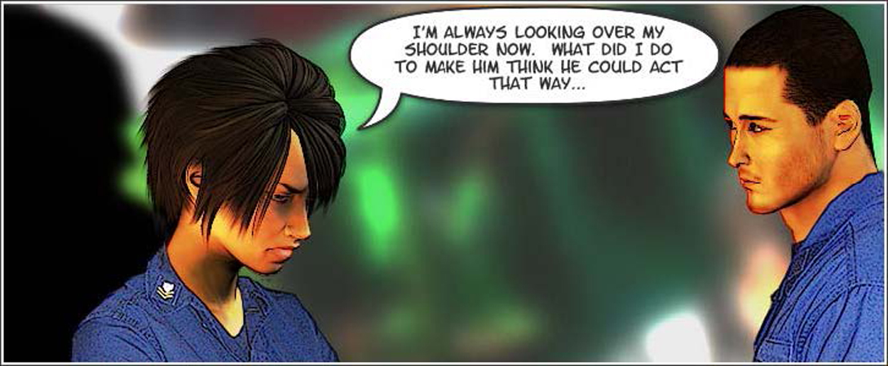
Section A:
Sexual Harassment or Sexual Assault
Besides recognizing the difference between acceptable and unacceptable behavior, you should know the difference between sexual harassment and sexual assault, particularly because the reporting procedures are different. Can you figure out which of the following scenarios is sexual harassment and which is sexual assault?

Slide 38
Section A:
Sexual Harassment or Sexual Assault
Every day at work, Andrea would have to face Ryan who would make catcalls at her and call her names as she passed. He would remark that a woman had no business doing her job.
One day, he blocked her way, came uncomfortably close to her, and suggested that they have sex. When she looked at him in shock, he laughed and walked away. What are Ryan’s actions?
  Sexual harassment
  Sexual assault
  Normal teasing

Slide 39
Section A:
Sexual Harassment or Sexual Assault
This is sexual harassment. The intimidation and proposition was threatening but Ryan did not actually touch her, so it cannot be considered sexual assault. However, he has created an atmosphere of fear and hostility for Andrea. Andrea will probably be concentrating more on avoiding and dealing with him than on her job, which will affect both her and those who rely on her. Ryan’s conduct is unacceptable and may be reported through sexual harassment reporting procedures.

Slide 40
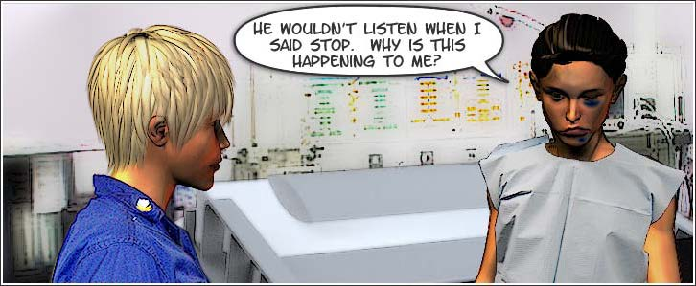
Section A:
Sexual Harassment or Sexual Assault
Hannah had started going out with fellow coastguardsman Patrick. He soon began to pressure her to become intimate but she wasn’t too sure she even wanted to continue seeing him.
Finally, Hannah told Patrick they needed to slow down and think things over.
A couple of days later, he cornered her, told her to stop playing games with him, then forced her to have sex. Hannah was too dazed to resist. What happened here?
  Sexual harassment
  Sexual assault
  Acceptable dating behavior

Slide 41
Section A:
Sexual Harassment or Sexual Assault
This is sexual assault, which involves unwanted sexual contact. Hannah’s lack of resistance was due to her fear and shock. She did not consent to sex; Patrick was wrong to assume that she was playing games with him and really wanted sex. Patrick’s lack of respect may lead to serious consequences for Hannah, such as flashbacks, self-blame, and phobias. Hannah can use the reporting options outlined in the Respond section of this course.

Slide 42
Section A:
Sexual Harassment or Sexual Assault
It is important for you to RECOGNIZE the difference between sexual harassment and sexual assault.
Review the each scenario below to learn why they are considered sexual harassment or sexual assault.
  While in his office’s supply closet, a coastguardsman is cornered by a coworker. She kisses him and then hits him when he pushes her away.
Being cornered and then subjected to an unwanted kiss and violence can have a traumatizing impact on a victim. Because the kiss was aggravated and wrongful sexual contact, it can be considered sexual assault.

Slide 43
Section A:
Sexual Harassment or Sexual Assault
It is important for you to RECOGNIZE the difference between sexual harassment and sexual assault.
Review the each scenario below to learn why they are considered sexual harassment or sexual assault.
  A coastguardsman is stalked by her supervisor during off-duty hours. He hints she’ll receive a poor performance evaluation if she tells anybody..
Unwanted attention of a sexual nature, regardless of the intention of the offender, is considered sexual harassment, as is using authority to make someone submit to sexual conduct. While there is no sexual contact in this case at this point, the coastguardsman should report her supervisor before the situation escalates.

Slide 44
Section A:
Sexual Harassment or Sexual Assault
It is important for you to RECOGNIZE the difference between sexual harassment and sexual assault.
Review the each scenario below to learn why they are considered sexual harassment or sexual assault.
  Coworkers tease other coworkers by putting up lewd photographs, making obscene gestures, and telling vulgar jokes.
Using sexual images, gestures, and words create an environment that is unwelcome and hostile to coworkers. This is considered sexual harassment.

Slide 45
Section A:
Sexual Harassment or Sexual Assault
It is important for you to RECOGNIZE the difference between sexual harassment and sexual assault.
Review the each scenario below to learn why they are considered sexual harassment or sexual assault.
  BM3 and his male shipmate drink heavily one night. After passing out, he wakes to realize that something uninvited of a sexual nature occurred.
Uninvited sexual contact is always considered sexual assault, even if it occurs between people of the same gender. Remember, same-gender assault does not indicate a specific sexual orientation for either the victim or offender.
This concludes Section A: Recognize: Where Is the Line?
Return to Course Sections

Slide 46
Section B: Prevent: How Do I Protect Myself?
Sexual assault is always a threat. But often, the risk of becoming a victim or an offender can be significantly reduced or even avoided by following preventative measures.
Showing respect for others, communicating, and being responsible about alcohol and drug use can help you avoid sexual offenses. Taking precautions to stay safe and maintaining awareness can minimize your risk of becoming a victim.
Section Objective:
Take actions to minimize the risk of becoming a sexual assault offender or victim.
This section presents a scenario as well as an article that details ways to prevent sexual assault. Read through the article found after the scenario to answer the scenario questions. There are also several short scenarios that give you the opportunity to consider ways to reduce the characters’ risks.

Slide 47
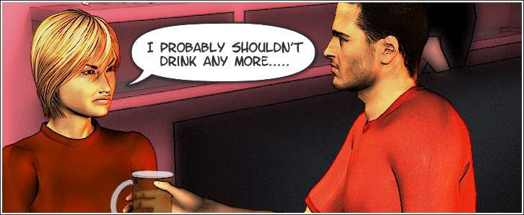
Section B: Prevent: How Do I Protect Myself?
Return to Course Sections

Slide 48
Section B: Prevent: How Do I Protect Myself?
Silvia attended a morale party, where, early in the evening, she had taken a few vodka shots. Nate walked up and offered her a beer.
Nate's determination made it hard for Silvia to resist the beer. Even though Silvia had hoped he would go away after one beer, they spent the evening drinking together.
Nate felt a little buzzed but Silvia was definitely drunk. At the end of the night, she felt it too late to call any of her friends. She saw her trusted friends, Adam and John, and wondered if they would loan her money for a taxi.
Before she could ask, Nate suggested, “Hey, let’s get out of here. Come on, I’ll give you a ride.” She went along with him.
He took her back to her place, where they made out. Soon, Silvia said, “Wow, I drank too much. I need to lay down.” When she did, she passed out. Nate began having sex with her, which, as he later learned, constitutes rape.
Read Article: Preventing Sexual Assault

Slide 49
Section B: Prevent: How Do I Protect Myself?
What should Nate have done differently to avoid being accused of rape?
  Watched his alcohol consumption
  Gotten someone else drunk who actually likes him
  Not had sex with someone who was drunk
  Not had sex with someone who had passed out
  Gotten verbal consent before she passed out
Even though the rape wasn’t her fault, what are some things Silvia could have done differently?
  Called her friends even if she had to wake them
  Not have laid down even if she was dizzy
  Asked Adam or John for help getting home
  Refused drinks from Nate even if he kept pestering her

Slide 50
Section B: Prevent: How Do I Protect Myself?
What should Nate have done differently to avoid being accused of rape?
  Watched his alcohol consumption
  Gotten someone else drunk who actually likes him
  Not had sex with someone who was drunk
  Not had sex with someone who had passed out
  Gotten verbal consent before she passed out
Nate’s alcohol consumption was enough that his judgment was probably clouded. In this case, combining sex and alcohol led to serious consequences. In addition, it was his responsibility to know that Silvia could not consent to sex since she was drunk and unconscious. By taking advantage of her while she was incapacitated he demonstrated a deep lack of respect towards her, her desires, and her well-being.

Slide 51
Section B: Prevent: How Do I Protect Myself?
Even though the rape wasn’t her fault, what are some things Silvia could have done differently?
  Called her friends even if she had to wake them
  Not have laid down even if she was dizzy
  Asked Adam or John for help getting home
  Refused drinks from Nate even if he kept pestering her
Please be aware that none of Silvia’s choices, no matter how poor, gave Nate the right to rape her. Rape is too traumatic to ever be justified as an appropriate punishment for any decision. However, to lower her risk, she could have called or asked a trusted friend for help. Most people would rather be a little inconvenienced than witness the aftermath of an assault of a loved one. Also, refuse drinks if you feel that you’ve had enough alcohol or if there is the possibility that it’s drugged.

Slide 52
Section B: Prevent: How Do I Protect Myself?
During a night of binge drinking and dancing, Peter started talking to Heidi who was standing next to him at the bar. They drank heavily for several hours until Heidi appeared to be drunk. She winked at Peter several times throughout the night, so Peter asked her if she wanted to come back to his place. At Peter’s apartment, they had sex. In the morning, Heidi had very little recollection of the evening and claimed that Peter sexually assaulted her. What should Peter have done differently?
  1. Been more responsible in his drinking
  2. Not have had sex with Heidi since she was obviously drunk
  3. Ensured that Heidi verbally consented to having sex
Correct answers: 1 and 2. Heidi is not capable of verbally consenting because she is intoxicated. Therefore, the best decision Peter could have made, besides having been more responsible in his drinking, to avoid being accused of sexual assault is to not have had sex with Heidi.

Slide 53
Section B: Prevent: How Do I Protect Myself?
Joseph had been receiving threats from others at work and started drinking heavily at night to deal with his problems. One night, when he was by himself at a bar, he saw his harassers and their friends, also drinking. He left, stumbling a little, and tried to walk home. He was followed and was assaulted physically and sexually. How could Joseph have lowered his risk in this situation?
  1. Controlled his drinking
  2. Fought back against his attackers
  3. Called a taxi to pick him up
  4. Gone out with others he can trust
Correct answers: 1, 3, and 4. Although Joseph could have made some safer choices, it is not his fault that he was subjected to violent behavior. Excessive alcohol can make it harder for a person to resist attack and make attackers more aggressive. Controlling your alcohol consumption and seeking help if you are dependent is crucial. When going out, make sure that you have a safe way home, (e. g. money for a taxi, a cell phone to call a friend). Avoid going out alone, especially to pubs, clubs, or parties; ask friends to go with you, so you can watch out for each other. Also, report threats to a supervisor or appropriate authority before they escalate to violence.

Slide 54
Section B: Prevent: How Do I Protect Myself?
Jessica met Aidan at a local bookstore. He seems aggressive and eccentric, but good-looking and intelligent. One day, he insists that she meet him at his apartment for dinner. She decides to accept just this once, despite being a little intimidated by him. During the date, Aidan gets much too close for Jessica’s comfort. When she asks him to back off, he gets angry and rapes her. How could Jessica have protected herself better?
  1. Not have confronted him about his behavior
  2. Trusted her instincts and said no
  3. Asked that they meet in a public place
Correct answers: 2 and 3. Never feel that you should get into or stay in a situation with other people that is unsafe or that makes you extremely uncomfortable. Always follow your instincts. You do not have to sacrifice your safety for another person’s wants. Give yourself permission to keep yourself safe. As a precaution, meet dates, especially first dates and blind dates, in a public place or in a double or group date setting; there is safety in numbers.

Slide 55
Section B: Prevent: How Do I Protect Myself?
Lindsey has a goal to get in shape for a race. She jogs whenever she can fit it into her schedule. From time to time, she doesn’t have any time to herself except before dawn or after dark. She would like to meet her goal but she also wants to stay safe. What can Lindsey do?
  1. Plan a route close to home
  2. Jog only during daylight hours
  3. Jog with friends
  4. Run really fast
  5. Train on a treadmill
Correct answers: 2, 3, and 5. Lindsey will need to find an alternative if she can’t exercise during the day, such as gather a group of friends to jog with her or use an indoor track or a treadmill at a safe location if available. She needs to be aware that even if she is strong or fast, she is still at an increased risk of something going wrong by jogging alone at night.

Slide 56
Section B: Prevent: How Do I Protect Myself?
Lindsey has a goal to get in shape for a race. She jogs whenever she can fit it into her schedule. From time to time, she doesn’t have any time to herself except before dawn or after dark. She would like to meet her goal but she also wants to stay safe. What can Lindsey do?
  1. Plan a route close to home
  2. Jog only during daylight hours
  3. Jog with friends
  4. Run really fast
  5. Train on a treadmill
Correct answers: 2, 3, and 5. Lindsey will need to find an alternative if she can’t exercise during the day, such as gather a group of friends to jog with her or use an indoor track or a treadmill at a safe location if available. She needs to be aware that even if she is strong or fast, she is still at an increased risk of something going wrong by jogging alone at night.
This concludes Section B: Prevent: How Do I Protect Myself?
Return to Course Sections

Slide 57
Section C: Respond: What Do I Do Now?
If you are a victim of sexual assault, your appropriate RESPONSE can be an important step towards resolution and recovery.
In the Coast Guard, two reporting options are available to provide valuable assistance and greater ability to regain control of your life.
Section Objective:
Take appropriate measures if you have been sexually assaulted.
This section presents a scenario as well as an article about sexual assault reporting options. Read through the article found after the scenarios to answer the scenario questions.

Slide 58

Section C: Respond: What Do I Do Now?
Return to Course Sections

Slide 59
Section C: Respond: What Do I Do Now?
Nate and Silvia were both at a morale party, where he was purposefully trying to get her drunk. As the night progressed, Silvia did get drunk like Nate had hoped and he offered her a ride, which she accepted.
He drove her home, where they made out, even though her judgment was too impaired for her to legally be able to consent to any sexual activity.
Soon, she felt dizzy, and subsequently passed out. Later, she woke to discover that Nate had begun raping her while she was out cold. After the assault finally ended, Silvia, feeling stunned and upset, wondered what to do.
Read Article: Responding as a Sexual Assault Victim

Slide 60
Section C: Respond: What Do I Do Now?
What should Silvia do immediately?
  Get away from Nate and to a safe place
  Avoid the hospital if she wants confidentiality
  Gather and take items he touched to the police
  Report the assault to her supervisor
  Call the Employee Assistance Program Coordinator (EAPC)/Sexual Assault Response Coordinator (SARC)
What might influence the reporting option that Silvia chooses?
  Silvia wants to maintain her confidentiality.
  Nate is threatening to harm Silvia.
  The EAPC/SARC decides that confidentiality is the best thing for Silvia.
  Silvia wants an investigation against Nate.

Slide 61
Section C: Respond: What Do I Do Now?
What should Silvia do immediately?
  Get away from Nate and to a safe place
  Avoid the hospital if she wants confidentiality
  Gather and take items he touched to the police
  Report the assault to their supervisor
  Call the Employee Assistance Program Coordinator (EAPC)/Sexual Assault Response Coordinator (SARC)
Silvia should focus first on personal safety, including getting to a safe place and seeking medical help. Medical care can be provided confidentially. She should contact the EAPC/SARC to receive guidance and support right away, but she does not need to report the assault to a supervisor. She should not move anything at the crime scene or even wash herself prior to a forensic exam, since valuable evidence could be lost.

Slide 62
Section C: Respond: What Do I Do Now?
What might influence the reporting option that Silvia chooses?
  Silvia wants to maintain her confidentiality.
  Nate is threatening to harm Silvia.
  The EAPC/SARC decides that confidentiality is the best thing for Silvia.
  Silvia wants an investigation against Nate.
The EAPC/SARC will guide and inform a victim but will typically allow the victim to choose an option if the assault has not been disclosed to anyone other than an EAPC/SARC, FAS, HCP or Victim Advocate. If Silvia decides that she would like an investigation initiated, she can choose unrestricted reporting, while restricted reporting is an option if she wishes for greater confidentiality. There are a few circumstances where restricted reporting is not an option.
This concludes Section C: Respond: What Do I Do Now?
Return to Course Sections

Slide 63
Section D: Prevent and Respond:
How Do I Help Others?
You can be a Guardian against sexual assault by knowing how to intercede safely to aid those in harm's way and by being supportive of any victims who ask for help.
By knowing how to PREVENT situations from escalating and to RESPOND appropriately, you will be ready to make a significant positive difference in the lives of those around you.
Section Objective:
Take appropriate measures when another person has been or may be sexually assaulted.
This section presents a scenario in two parts. It also includes an article that discusses how you can prevent violent situations and respond to victims and potential victims of sexual assault. Read through the article found after the scenarios to answer the scenario questions.

Slide 64
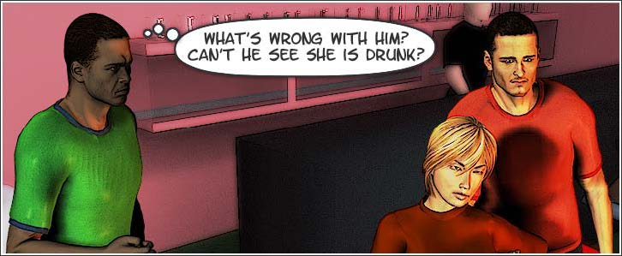
Section D: Prevent and Respond:
How Do I Help Others?
Return to Course Sections

Slide 65
Section D: Prevent and Respond:
How Do I Help Others?
Adam and his shipmates, John and Grant, were at the morale party where Nate had been purposely working to get Silvia drunk. Later on, Nate seemed a bit buzzed and Silvia was obviously drunk.
They were flirting in a way that Silvia would never even consider if she was sober and she was even making some suggestive comments. Adam noticed Nate trying to convince Silvia to leave with him.
Concerned, Adam told John and Grant that they should engage Nate in conversation while one of them speaks to Silvia privately, but John was more ready just to tell Nate off.
Grant felt that they shouldn’t intervene since Silvia is a smart girl and could get out of the situation on her own if she is truly uncomfortable.
Read Article: Helping Victims of Sexual Assault?

Slide 66
Section D: Prevent and Respond:
How Do I Help Others?
Which plan would be the best approach to take?
  John’s (confront Nate)
  Adam’s (distract Nate)
  Grant’s (let Silvia decide for herself)
If Nate becomes violent, what should the three bystanders do?
  Call the police
  Apologize for interfering
  Fight back

Slide 67
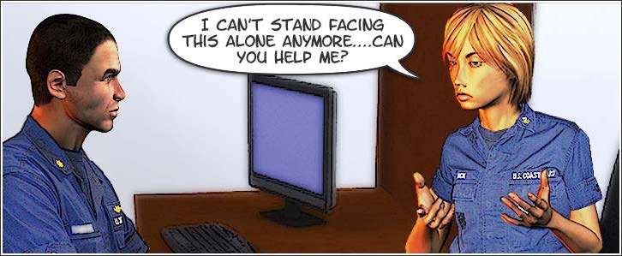
Section D: Prevent and Respond:
How Do I Help Others?

Slide 68
Section D: Prevent and Respond:
How Do I Help Others?
One day, Silvia walked into her supervisor Joel’s office and asked, “Are you busy?” He noticed how teary she was and asked her to sit down.
She described what happened to her during and after a morale party. A guy at the party, she said, had taken her back to her place and made out with her when she was drunk.
She told Joel that she then passed out and woke some time later to find him raping her. Tearfully, Silvia looked at Joel and added, “I can’t stand this. I don’t know what to do. Can you help me?”

Slide 69
Section D: Prevent and Respond:
How Do I Help Others?
Could the way Joel reacts make a difference?
  Yes
  No
Many victims fear that others will not believe them, or else embarrass or blame them. Silvia probably feels that she has taken a major risk by speaking about the rape. If Joel responds appropriately, she will be far more likely to feel like others will not reject or criticize her, receive the medical and counseling support that she may want or need, and be protected from further harm.

Slide 70
Section D: Prevent and Respond:
How Do I Help Others?
What are some appropriate steps Joel could take to help Silvia?
  Listen to what she has to say
  Try to help her figure out what went wrong
  Give her advice about how to recover
  Collect information about the offender and the assault
Joel can comfort Silvia by listening to her, but asking for details may be intrusive and could even hurt any investigation later. Likewise, placing blame or giving unsolicited advice could be more harmful than helpful.

Slide 71
Section D: Prevent and Respond:
How Do I Help Others?
What are some appropriate steps Joel could take to help Silvia?
  Drive her to the hospital if she asks
  Contact the Employment Assistance Program Coordinator (EAPC)/Sexual Assault Response Coordinator (SARC)
  Contact her family without asking her first
Joel needs to first ensure her safety and medical needs are met. Next, he should contact the EAPC/SARC so they can support her and inform her of her choices. He should not contact her family, since that may violate her wishes at a time when she needs to feel more in control of her life.
This concludes Section D: Prevent & Respond: How Can I Help Others?

Slide 72
Conclusion
Sexual assault is not about romance and sexual desire. It’s about exercising power over and humiliating another human being, using sexual conduct as a weapon. It violates the Coast Guard Core Values of Honor, Respect, and Devotion to Duty.
Being a Guardian against sexual assault requires being able to recognize the difference between acceptable and unacceptable conduct. Be especially certain to know the difference between consent and lack of consent.
You must also be able to prevent and respond to sexual assault. Take precautions, especially when alcohol is involved. Use the Coast Guard’s reporting options when needed. Help others in risky situations by assessing the situation, being with others, and caring for the victim. Listen to victims, make sure they are safe, and help them get the assistance they want and need.

Slide 73
Conclusion
Remember to Recognize, Prevent, and Respond!
1. Recognize: There is a difference between unacceptable and acceptable conduct.
In order to prevent and respond to sexual assault, you will need to recognize the difference between appropriate and inappropriate sexual conduct.
2. Prevent: Sexual assault can often be prevented.
Knowing what actions you and others can take to prevent becoming a sexual assault offender or victim can help keep you out of trouble. Furthermore, there are actions you can take to help others avoid potentially dangerous situations.
3. Respond: Sexual assault need to be responded to appropriately.
When sexual assault does occur, appropriate response can do much to protect and help to heal victims and bring offenders to justice.
The course also contains three posters that you can print out and post in your workspace, as well as a job aid that you can keep for your reference. This should help to remind everyone how they can recognize, prevent, and respond to sexual assault.
Poster Tips Poster Consent Poster abcs Poster Jobaid

